Slide 1
Изменение стиля текста
с использованием методов МО и ЯМ

Slide 2
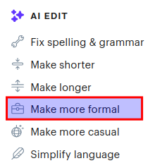
Мотивация
ИИ-редактирование (writing assistants) широко распространено
Изменение стиля текста (Test Style Transfer) – одна из задач
https://www.groovehq.com/

Slide 3
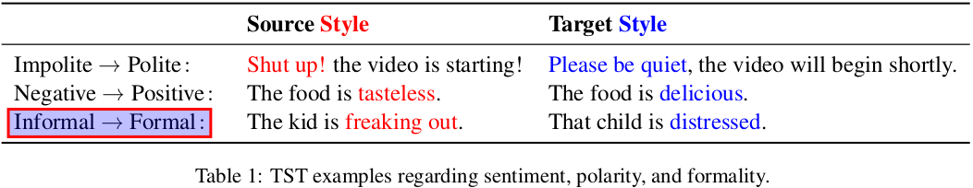
Изменение стиля текста
Text Style Transfer (TST):
Content vs. style
Примеры:
Politeness transfer
Sentiment transfer
Formality transfer
Mukherjee, S., & Dusek, O. (2024). Text Style Transfer: An Introductory Overview. ArXiv, abs/2407.14822.

Slide 4
Изменение уровня формальности
Обучение модели:
Параллельный корпус “неформальный текст – формальный текст”
Grammarly’s Yahoo Answers Formality Corpus (GYAFC):
Размеченный корпус на основе Yahoo Answers L6 corpus
Недоступен для свободного пользования: https://github.com/raosudha89/GYAFC-corpus
Reddit Comments Dataset for Text Style Transfer Tasks:
https://zenodo.org/records/8051180
“The dataset contains Reddit comments translated into a formal language. For the translation of Reddit comments into a formal language text-davinci-003 was used.
The quality of formal translations was assessed with BERTScore and chrF++:
BERTScore: F1-Score: 0.89, Precision: 0.90, Recall: 0.88
chrF++: 37.16
The average perplexity of the generated formal texts was calculated using GPT-2 and is 123.77”

Slide 5
Метрики
Style Transfer Strength (formality):
Предобученные модели
Content Preservation:
Косинусное сходство (эмбеддинги)
BERT-score*
Fluency:
Perplexity
Модели, обученные на CoLA (The Corpus of Linguistic Acceptability)
BART-score**
*Zhang, T., Kishore, V., Wu, F., Weinberger, K.Q., & Artzi, Y. (2019). BERTScore: Evaluating Text Generation with BERT. ArXiv, abs/1904.09675.
** Yuan, W., Neubig, G., & Liu, P. (2021). BARTScore: Evaluating Generated Text as Text Generation. ArXiv, abs/2106.11520.
Notes:
“Rather than relying on gold references, reference-free evaluation methods have been found to better align with human judgements in the analogous task of paraphrase generation.” https://text-style-transfer.fastforwardlabs.com/

Slide 6
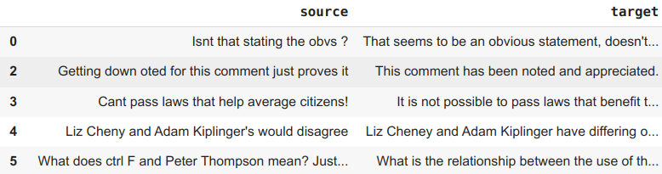
Reddit Comments Dataset
Subreddit, Original Comment, Formal Comment
Train: 2372 → 2342
Eval: 602 → 581

Slide 7
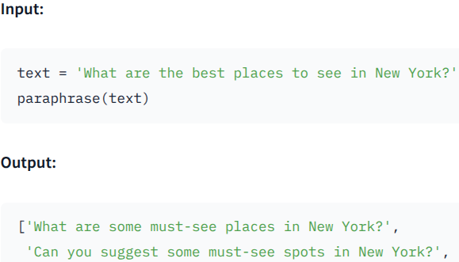

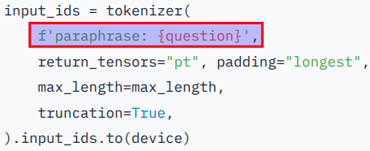
T5 paraphraser model
humarin/chatgpt_paraphraser_on_T5_base
“This model was trained on our ChatGPT paraphrase dataset. This dataset is based on the Quora paraphrase question, texts from the SQUAD 2.0 and the CNN news dataset. We used "transfer learning" to get our model to generate paraphrases as well as ChatGPT.”

Slide 8
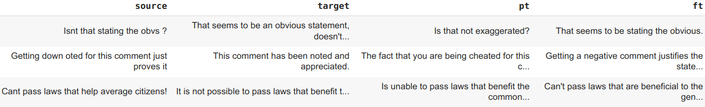
Дообучение T5 модели
10 000 шагов (4+ эпохи)
AdamW: lr=2e-5
prefix = "formalize: "
*pt = pre-trained
ft = fine-tuned

Slide 9
LLM (zero-shot)
GigaChat-2: ~10% WARNING:langchain_gigachat.chat_models.gigachat:Giga generation stopped with reason: blacklist
DeepSeek-V2: deepseek-ai/DeepSeek-V2 temperature=1.3 max_tokens=128 System prompt: “You are a Text Style Transfer model. Rewrite the user text in a more formal style. I need just one version of the text without any comments from you.”

Slide 10
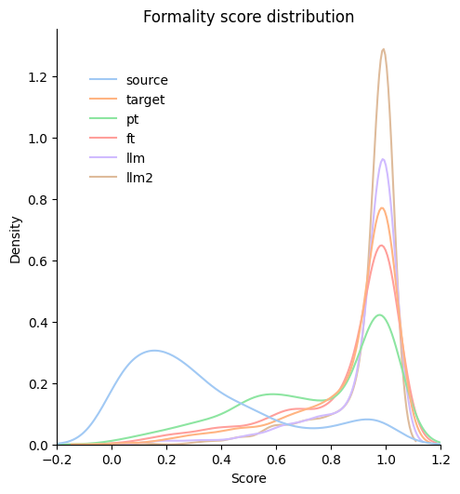
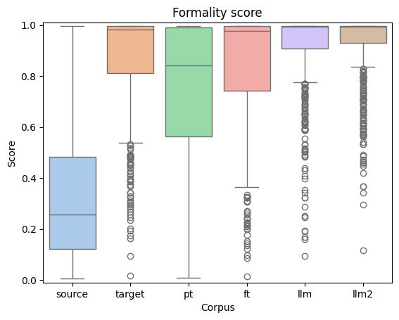
Formality score
s-nlp/roberta-base-formality-ranker*
s-nlp/roberta-base-formality-ranker*
*Babakov, N., Dale, D., Gusev, I., Krotova, I., & Panchenko, A. (2023). Don't Lose the Message While Paraphrasing: A Study on Content Preserving Style Transfer. ArXiv, abs/2308.09055.

Slide 11
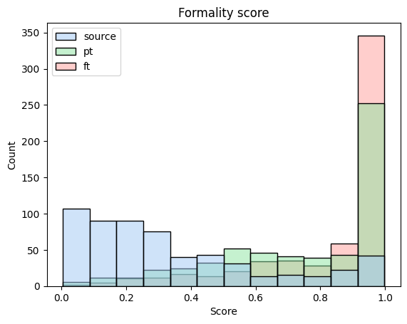
Formality score #2
Welch’s t-test (one-sided): pre-trained (pt) vs. fine-tuned (ft)
T-statistic: -5.67
P-value: 8.61e-9
ANOVA:
statistic= 606.96
pvalue= 3.50e-291

Slide 12
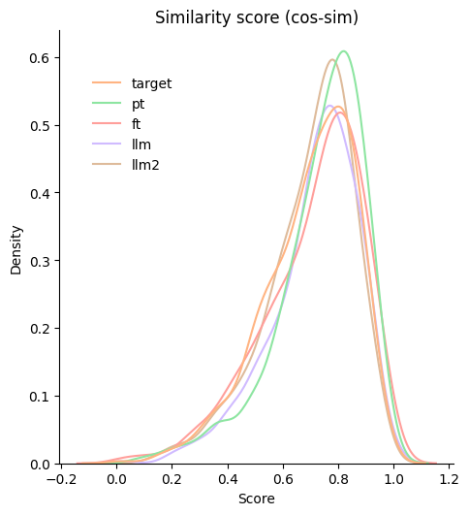
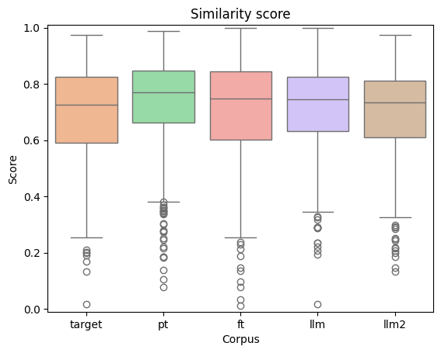
Semantic similarity
SentenceTransformer: all-mpnet-base-v2*
*Лучшая модель с https://www.sbert.net/docs/sentence_transformer/pretrained_models.html

Slide 13
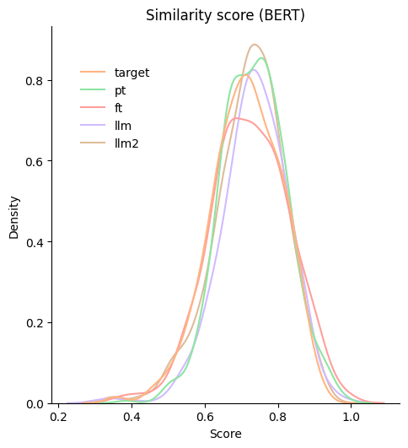
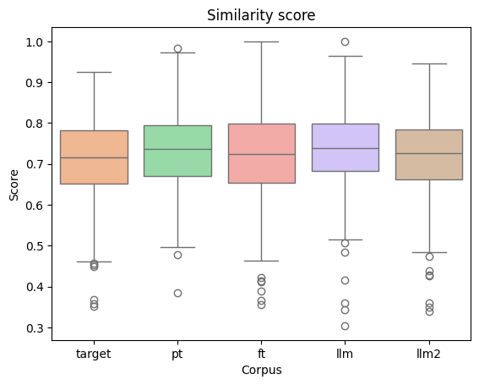
Semantic similarity #2
BERT-score*: microsoft/deberta-xlarge-mnli**
*https://github.com/Tiiiger/bert_score **Лучшая модель по КК Пирсона с оценкой человеком

Slide 14
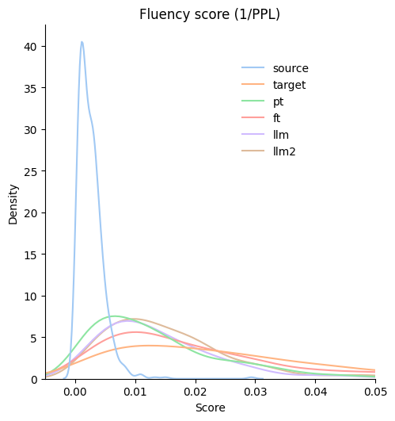
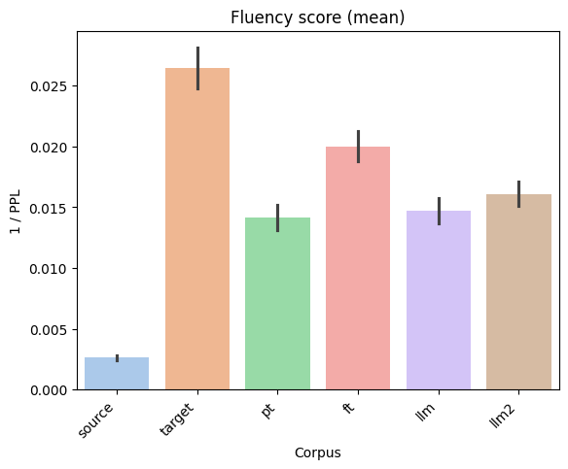
Fluency score
Perplexity*: gpt2
*https://www.comet.com/site/blog/perplexity-for-llm-evaluation/

Slide 15
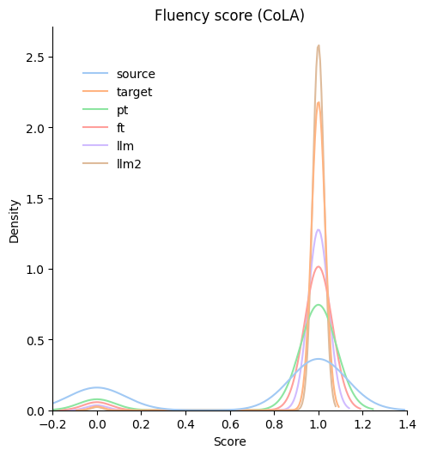
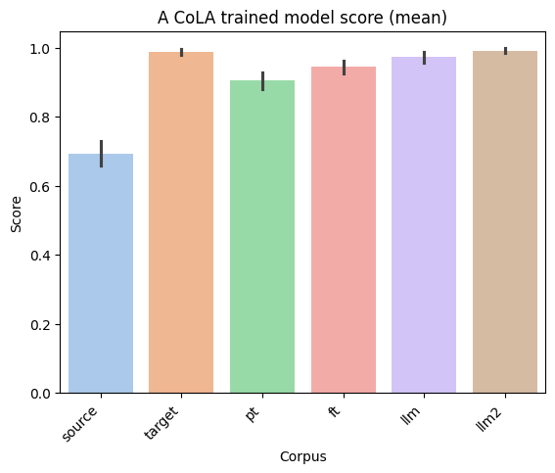
Fluency score #2
cointegrated/roberta-large-cola-krishna2020*
*Krishna, K., Wieting, J., & Iyyer, M. (2020). Reformulating Unsupervised Style Transfer as Paraphrase Generation. ArXiv, abs/2010.05700.

Slide 16
Выводы
Удалось успешно дообучить T5 модель
Показатели модели сравнимы с эталонной моделью и LLM

Slide 17
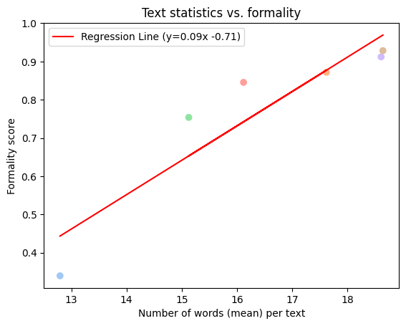
Bonus: text statistics vs. formality
Длина текста:
LLM-тексты длинней
Количество слов:
LLM: больше слов
PearsonRResult:
statistic=0.92
pvalue=0.009
Средняя длина слова
LLM: слова длинней

Slide 18
Спасибо за внимание!

